Slide 1
Fleet Management

Slide 2
KPIs for Fleet Management
Optimizing Fleet Performance and Efficiency
Name :- Mark Pereira
Date :- 17/05/2024

Slide 3
Fleet Management KPI (Key Performance Indicators)
---Company Important KPI’s
All Litres Consumed
Total Drives
Total Kilometre Travelled
Total Fix Cost
Total Fuel Cost
Total Fuel Consumed
Maintenance Cost
---Drivers KPI’s
Average Speed
Average Fuel Effeciency
Fuel Consumption per kilometre
Fuel Cost Per Kilometer

Slide 4
Importance of KPIs in Fleet Management
Purpose: To track and improve fleet performance, efficiency, safety, and cost-effectiveness

Slide 5
Other Important KPI’s Which can be considered are
Operational KPIs
Fleet Utilization Rate: Measures the percentage of the fleet that is actively in use.
  Formula: (Number of Active Vehicles / Total Fleet Size) * 100
Vehicle Downtime: Tracks the amount of time vehicles are out of service for maintenance or repairs.
  Formula: Total Downtime Hours / Number of Vehicles
Maintenance Cost per Vehicle: Monitors the average maintenance cost for each vehicle in the fleet.
  Formula: Total Maintenance Costs / Number of Vehicles
Fuel Efficiency: Measures the average fuel consumption of the fleet.
  Formula: Total Fuel Consumed / Total Distance Traveled
Accident Rate: Tracks the number of accidents per vehicle or per mile/kilometer.
  Formula: (Number of Accidents / Total Distance Traveled) * 100

Slide 6
Other Important KPI’s Which can be considered are
Financial KPIs
Total Cost of Ownership (TCO): Includes all costs associated with owning and operating the fleet, such as purchase, maintenance, fuel, insurance, and depreciation.
  Formula: Sum of All Fleet Costs
Cost per Mile/Kilometer: Measures the cost efficiency of the fleet based on distance traveled.
  Formula: Total Fleet Costs / Total Distance Traveled
Lease Cost per Vehicle: Monitors the average leasing cost for each vehicle.
  Formula: Total Lease Costs / Number of Leased Vehicles

Slide 7
Other Important KPI’s Which can be considered are
Compliance and Safety KPIs
Compliance Rate: Tracks the percentage of vehicles that comply with regulatory standards and inspections.
  Formula: (Number of Compliant Vehicles / Total Fleet Size) * 100
Driver Safety Score: Evaluates driver performance based on safety metrics such as speed, harsh braking, and adherence to traffic laws.
  Formula: (Sum of Safety Metric Scores / Number of Drivers)

Slide 8
Other Important KPI’s Which can be considered are
Customer Service KPIs
Customer Satisfaction Score: Measures client satisfaction with fleet services.
  Formula: (Sum of Satisfaction Ratings / Number of Responses)
Response Time to Issues: Tracks the average time taken to respond to and resolve client issues or vehicle breakdowns.
  Formula: Total Response Time / Number of Issues

Slide 9
Other Important KPI’s Which can be considered are
Sustainability KPIs
Fleet Carbon Emissions: Measures the total CO2 emissions produced by the fleet.
  Formula: Total CO2 Emissions / Number of Vehicles
Percentage of Green Vehicles: Tracks the proportion of eco-friendly vehicles in the fleet (e.g., electric or hybrid vehicles).
  Formula: (Number of Green Vehicles / Total Fleet Size) * 100

Slide 10
Sample Visualization Ideas
Bar Charts: Compare fleet utilization rates, maintenance costs, and accident rates across different time periods or vehicle types.
Line Charts: Show trends over time for fuel efficiency, total cost of ownership, and response times to issues.
Pie Charts: Display the composition of fleet types, such as the percentage of green vehicles versus traditional vehicles.
Heat Maps: Visualize geographic data related to vehicle locations, accident hotspots, or service areas.
Gauge Charts: Indicate performance against targets for KPIs like compliance rate, driver safety score, and customer satisfaction score.
By incorporating these KPIs into your Power BI report, you can provide valuable insights into fleet performance, helping stakeholders make informed decisions to improve efficiency, safety, and sustainability.

Slide 11
Power BI Dashboard
Creating a Power BI dashboard based on the KPIs for fleet management involves designing a series of visualizations and arranging them in a way that allows stakeholders to quickly gain insights. Steps Included are as follows:-
Step 1: Data Preparation
Step 2: Define the Data Model
Step 3: Create the Visualizations
Step 4: Assemble the Dashboard
Step 5: Publish and Share
Step 6: Maintaininig the Dashboard

Slide 12
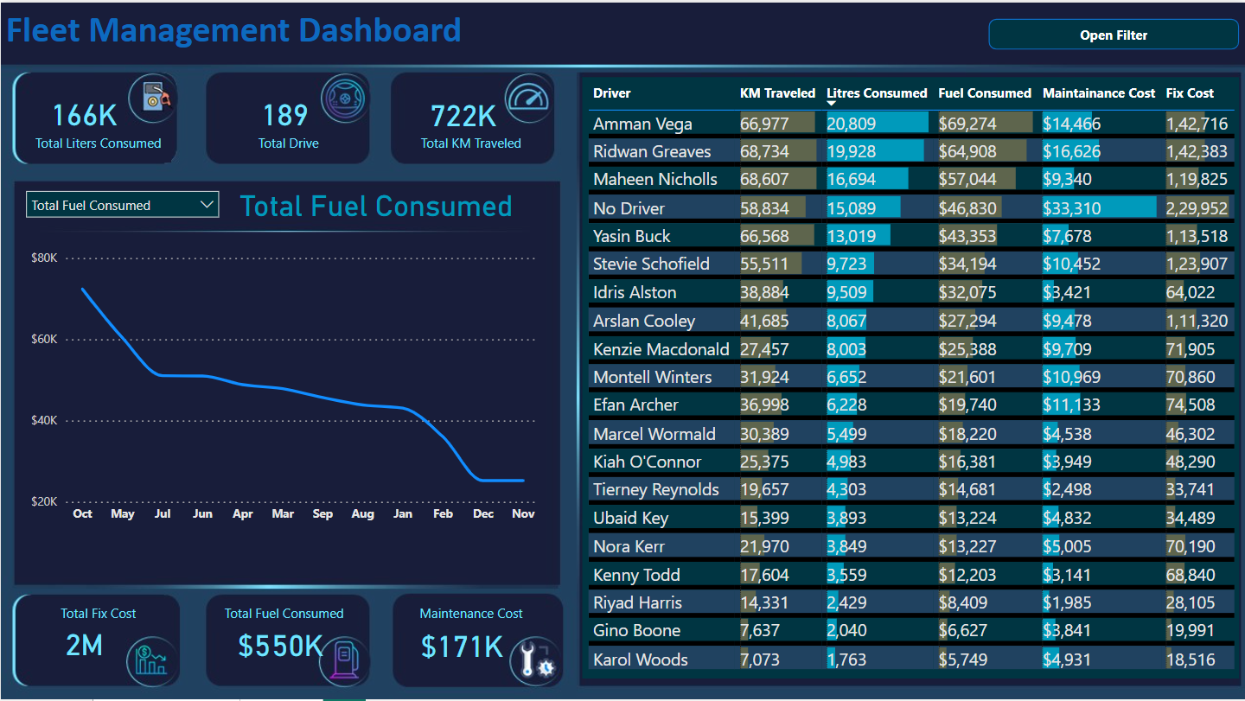

Slide 13
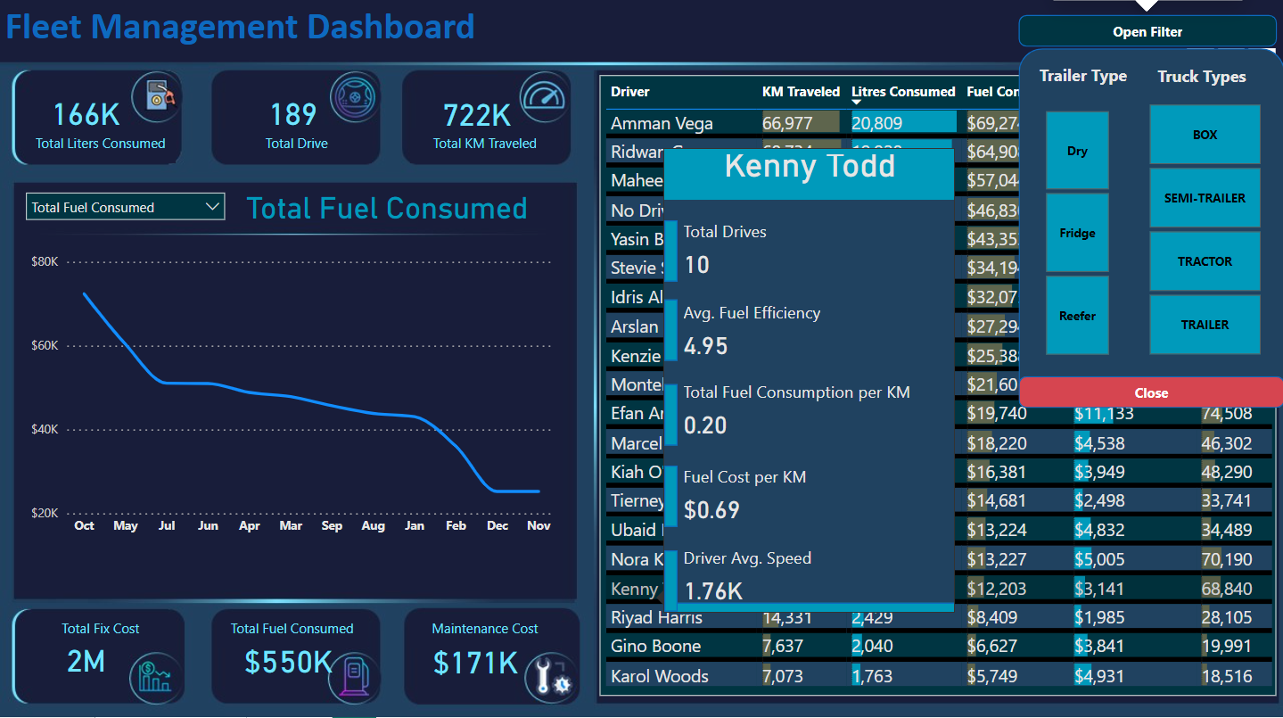

Slide 14
Thank You

